Slide 1
Dr. Yifeng Zhu Electrical and Computer Engineering University of Maine
Embedded Systems with ARM Cortex-M Microcontrollers in Assembly Language and C
Chapter 20
Analog-to-Digital Converter (ADC)
Spring 2020

Slide 2
Analog-to-Digital Converter (ADC)
V_{REF}
ADC
clock
Analog signal
x(t)
Digital values
x(n)
Resolution
Quantization error
Sampling rate
continuous time
continuous amplitude
discrete time
discrete amplitude
Notes:
An ADC converts a continuous-time and continuous-amplitude analog signal, such as a sensor output, to a discrete-time and discrete-amplitude digital signal. The performance of an ADC is primarily characterized by its resolution, sampling rate, and power dissipation.

Slide 3
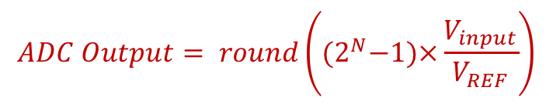

ADC: Resolution
Resolution: number of binary bits in ADC output.
V_{REF}
ADC
$$ADC Output= round\left({(2}^{N}−1)×\frac{V_{input}}{V_{REF}}\right)$$
V_{input}
clock
N: resolution
V_{REF}: the maximum input voltage that can be converted by the ADC
Example: for 10-bit ADC, V_{input} = 1V, V_{REF} = 5V
$$ADC Output= round\left(1023×\frac{1}{5}\right)=round\left(204.6\right)=205=0xCD$$

Slide 4
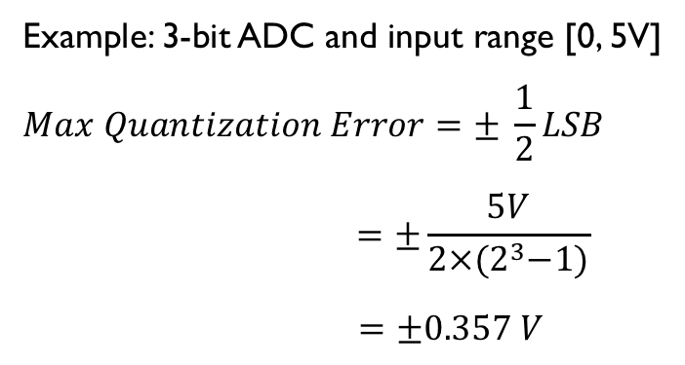
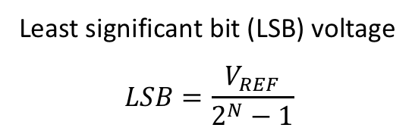

ADC: Quantization Error
Resolution N: number of binary bits in ADC output.
$$Digital Result= round\left({(2}^{N}−1)×\frac{V_{input}}{V_{REF}}\right)$$
Example: Resolution = 3 bits
Least significant bit (LSB) voltage
$$LSB=\frac{V_{REF}}{2^{N}−1}$$
Max quantization error = ±½ LSB
1 LSB
Example: 3-bit ADC and input range [0, 5V]
$$Max Quantization Error=± \frac{1}{2}LSB$$
$$=±\frac{5V}{2×{(2}^{3}−1)}$$
$=±0.357 V$
½ LSB

Slide 5
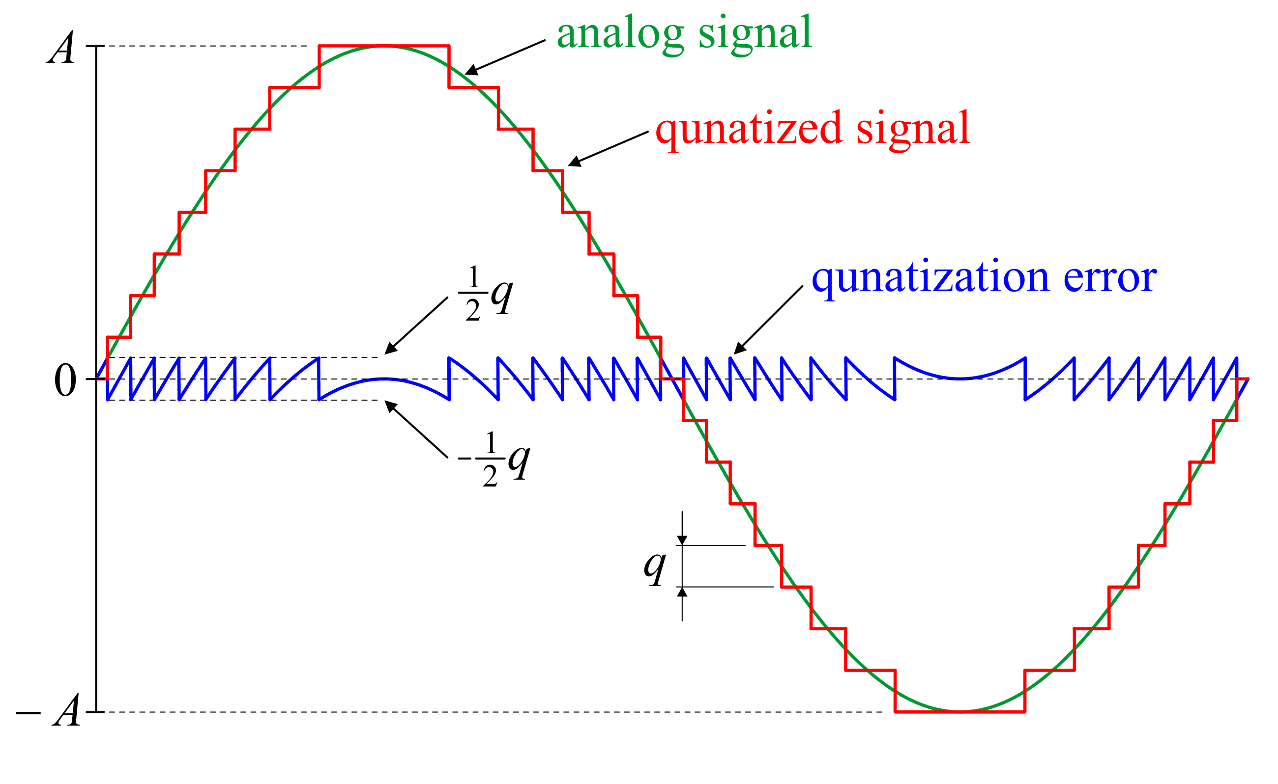
Example of Quantization Error
½ LSB
- ½ LSB
LSB
Marek Gasior, Analog digital conversion, CERN Beam Instrumentation Group, BI CAS 2018, Tusula, Finland
Notes:
A – input signal amplitude
n – number of bits
q – one bit amplitude:

Slide 6
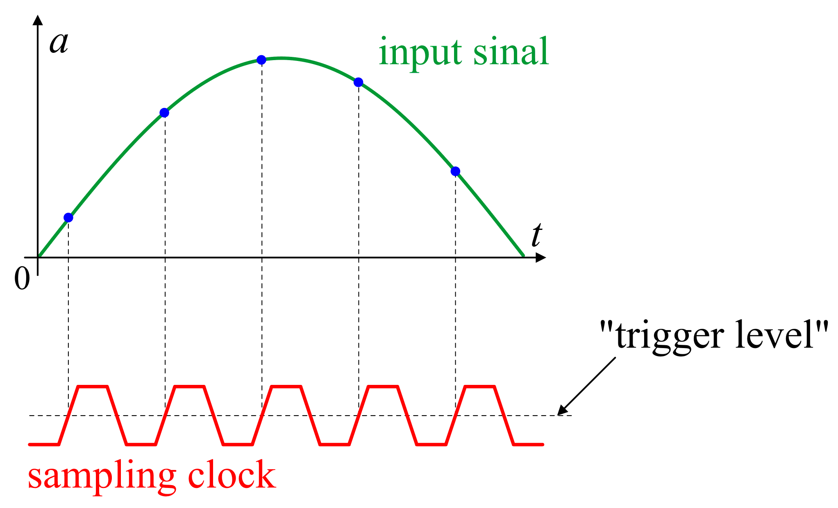
ADC: Sampling rate
Number of ADC output samples available per unit time.

Slide 7

What sampling rate do we need?
Nyquist–Shannon Sampling Theorem
$f_{sampling}≥2{∙f}_{signal}$
http://195.134.76.37/applets/AppletNyquist/Appl_Nyquist2.html

Slide 8
ADC Architecture
Popular ADC Architectures:
Successive-approximation (SAR)
Sigma-delta (Σ-Δ),
Pipeline
https://www.analog.com/en/analog-dialogue/articles/the-right-adc-architecture.html

Slide 9
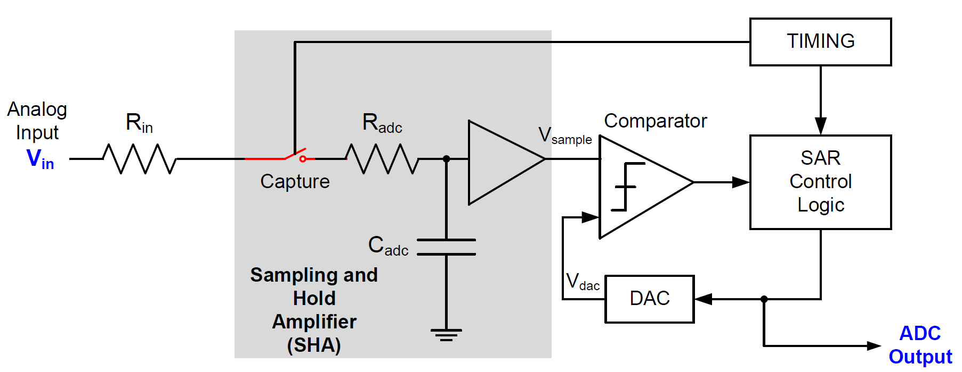
Successive-approximation (SAR)

Slide 10
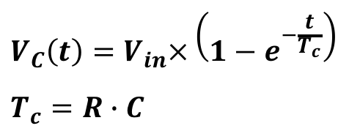
Determining Minimum Sampling Time
½ LSB
R
V_{IN}
V_{C}
C
$$V_{C}\left(t\right)=V_{in}×\left(1−e^{−\frac{t}{T_{c}}}\right)$$
$$T_{c}=R∙C$$
sampling time
Sampling time is software programmable
Sampling time must large enough to settle within ½ LSB

Slide 11
Programming ADC Sampling Time
2.5 cycles
HSI Clock
ADC Clock
6.5 cycles
Prescaler
/1, /2, /4
12.5 cycles
16 MHz
24.5 cycles
Selection
default prescaler = 1
47.5 cycles
92.5 cycles
247.5 cycles
640.5 cycles
ADC sample time registers
(SMPR1 and SMPR2)

Slide 12
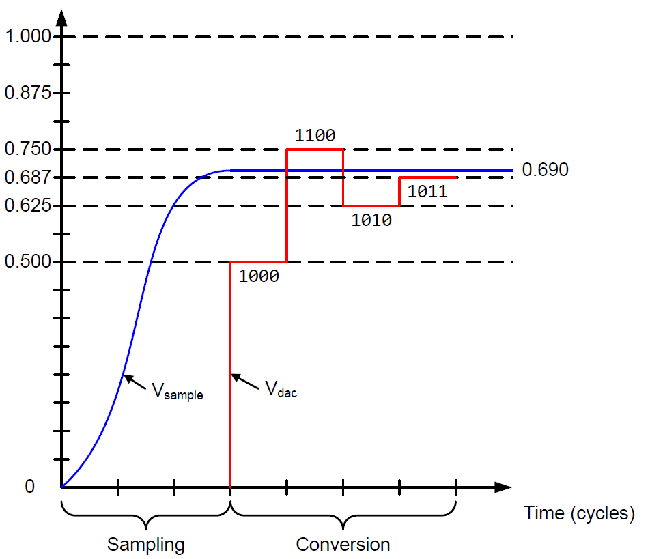
Successive-approximation (SAR) ADC
Binary search algorithm to gradually approaches the input voltage
Settle into ±½ LSB bound within the time allowed
N cycles for N-bit ADC
Notes:
In the conversion phase, the device uses a binary search strategy to find the desired digital output.
The binary search starts with the most significant bit decision, and the tests are repeated for each binary bit until the least significant bit decision is made. The value of each binary bit is based on whether the analog input voltage is higher or lower than the DAC voltage. It gradually approaches the input value and eventually settles within the half LSB error bound.
One way to under the binary search algorithm mis to recall how to play the high low game. You are asked to guess a secrete number says between 0 to 100. At every guess, you will be told whether your guess is higher or lower than the secrete number. To minimize the number of guesses, we should select the middle value between the largest and smallest possible numbers. Thus, our first guess should be 50.
In this 4-bit ADC example, the conversion phase takes four clock cycles. During the first cycle, the analog input is compred againt 1000, which represents 0.5 times the reference voltage. Since the input is larger, during the second cycle, the analog input is compared with 0.75 of the reference voltage. Since the input is smaller, in the third cycle the input is compared with 0.625 times the reference voltage. And in the last cycle, it compares the input with 0.687.
The ADC total conversion time equals to the sum of the sampling time and the conversion time. The conversion time takes N cycles, where N is the number of bits in the ADC output, i.e., ADC resolution. As discussed previously, software can configure the the samping time.

Slide 13

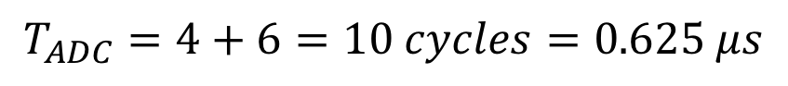
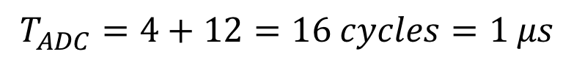
ADC Conversion Time
$$T_{ADC}=T_{sampling}+T_{Conversion}$$
Suppose ADC clock = 16 MHz, and Sampling time = 4 cycles
For 12-bit ADC
$$T_{ADC}=4+12=16 cycles=1 μs$$
For 6-bit ADC
$$T_{ADC}=4+6=10 cycles=0.625 μs$$

Slide 14
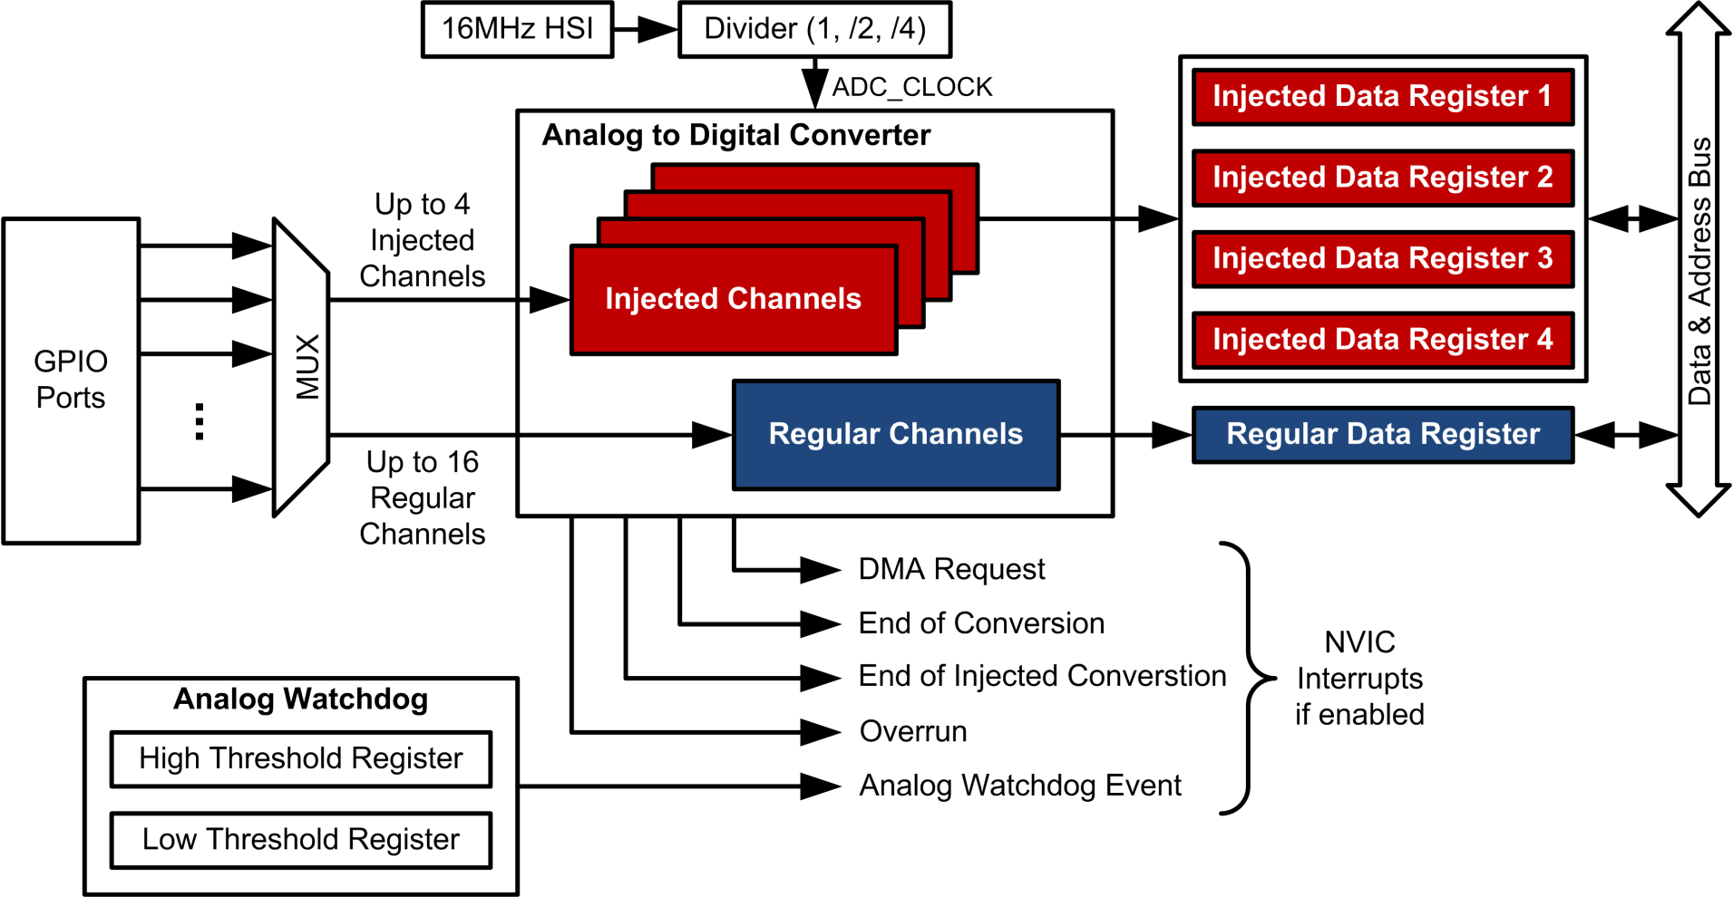
ADC: Regular vs injected
Notes:
This is the ADC module within STM32 microcontrollers. The ADC module itself is a 12-bit successive approximation converter. Each converter can support a total of 16 regular channels and 4 injected channels. The module supports a flexible sequences to convert up to 16 channels in any desired order. Each channel can have different sampling period.

Slide 15
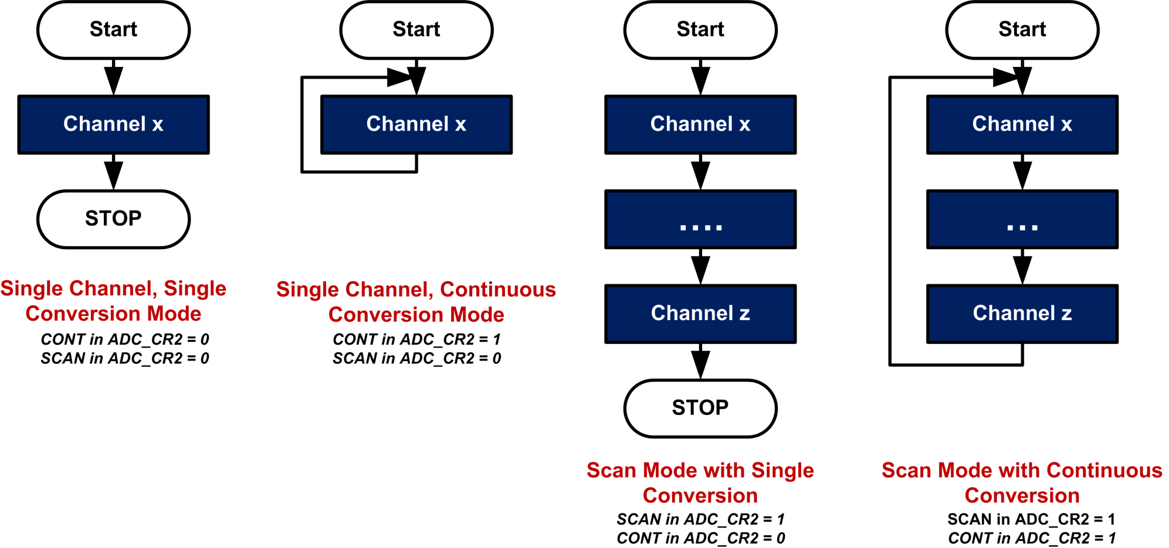
ADC Conversion Modes
Single Channel Mode
Scan Mode
Notes:
The ADC module supports several conversion modes:

Slide 16
Example 1: ADC with Polling (Busy Waiting)
Main program
(ADC in single conversion mode)
Software starts one ADC conversion on a single channel.
ADC1->CR |= ADC_CR_ADSTART;
ADC
Wait until EOC_MST is set in ADC common status register (CSR)
Hardware sets EOC_MST if done.
Result = ADC1->DR;
Repeat if more conversions are needed

Slide 17
Example 2: ADC with Interrupts
Main program
Configure and Starts ADC
void ADC1_2_IRQHandler(void){
if (ADC1->ISR | ADC_ISR_EOC){
buffer[i] = ADC1->DR;
i++;
}
...
}
An ADC interrupt request arrives.

Slide 18
Example 3: ADC Triggered by a Timer
V_{REF}
ADC
V_{input}
Digital Output
clock
trigger
ADC clock
Timer
TRGO
Timer clock
clock
OC1REF
Channel #1

Slide 19
Example 3: ADC Triggered by a Timer
main program
start timer
Timer
TRGO signals
ADC
interrupt request
ADC ISR
Wait for ADC_Done = 1
volatile uint ADC_Done = 0;
void ADC1_2_IRQHandler(void){
if (ADC1->ISR | ADC_ISR_EOC){
result[i] = ADC1->DR;
i++;
if (i >= N)
ADC_Done = 1;
}
...
}
Process Data
Repeat
Make N sampling

Slide 20
Example 4: ADC Triggered by a Timer with DMA
main program
DMA copies ADC DR register to memory after each conversion.
start timer
Timer
TRGO signals
DMA
request
ADC
DMA
controller
interrupt
request
Wait for DMA_Done = 1
DMA ISR
Process Data
volatile uint DMA_Done = 0;
void DMA1_Channel1_IRQHandler(void){
...
DMA_Done = 1;
...
}
Repeat
Make N sampling

Slide 21
Backup Slides

Slide 22
ADC: Single Conversion Mode
Regular channel:
Set SWSTART in ADC_CR2
The channel is selected by SQ1[4:0] in SQR5
Result is stored in ADC_DR
EOC is set after conversion
Interrupt is generated if EOCIE is set
Injected channel:
Set JSWSTART in ADC_CR2
The channel is selected by JSQ1[4:0] in JSQR
Result is stored in ADC_JDR1
JEOC is set after conversion
Interrupt is generated if JEOCIE is set

Slide 23
ADC: Scan Conversion Mode
Channels are selected by ADC_SQRx registers for regular channels, and by ADC_JSQR register for injected channel
All channels in a regular group share the same result register ADC_DR. Make sure to read data between consecutive sampling.
Notes:
In the scan mode, a set of pre-defined input channels are sampled in single-short or continuous mode.

Slide 24
Analog Watchdog
Analog voltage
Two programmable thresholds
Higher threshold (HTR)
Guarded Area
Lower threshold (LTR)
If V < V_{LTR} or V > V_{HTR}, the analog watchdog (AWD) flag (in ADC Status Register) is set, generating an interrupt to the processor
The monitor is automatically performed by hardware, not software
Convenient and efficient feature
Help processor detect exceptions and recover from specific situations
For example, monitor sensor data and raise alarm on some level.

Slide 25

V_{REF}
Some chips does not expose V_{REF} to a pin
STM32L LQFP64 does not have V_{REF} pin
STM32L LQFP100 does
Infer internal V_{REF}
How?
Corresponds to $V_{REF}$

Slide 26
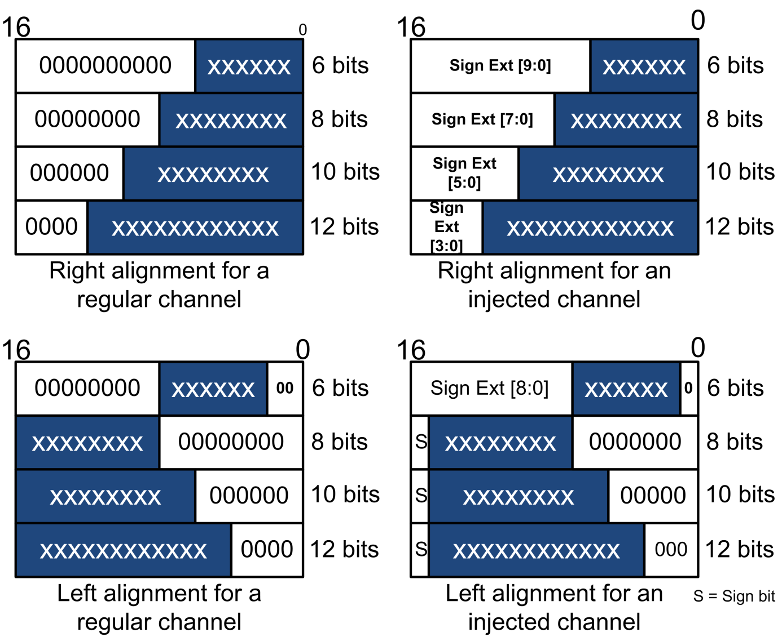
Data Alignment

Slide 27
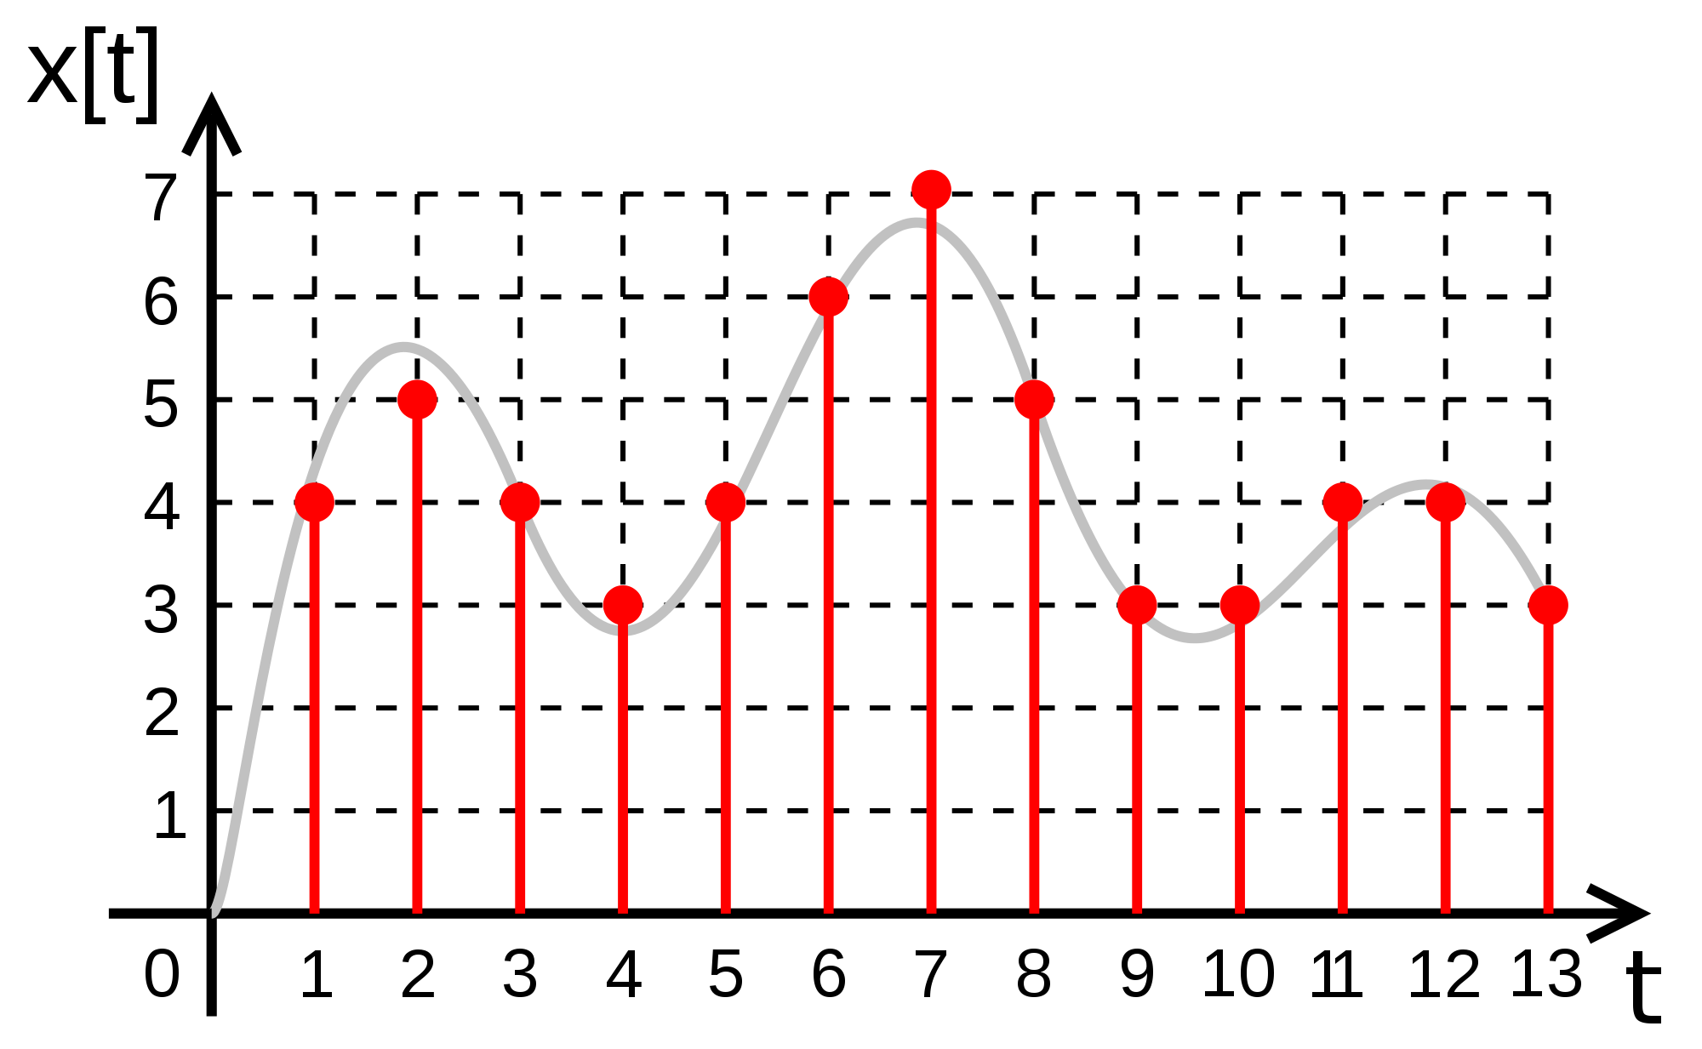

Slide 28
Voltage
111
7
110
6
101
5
100
4
011
3
010
2
001
1
000
0
1
2
3
4
5
6
7
8
time (ms)

